Slide 1
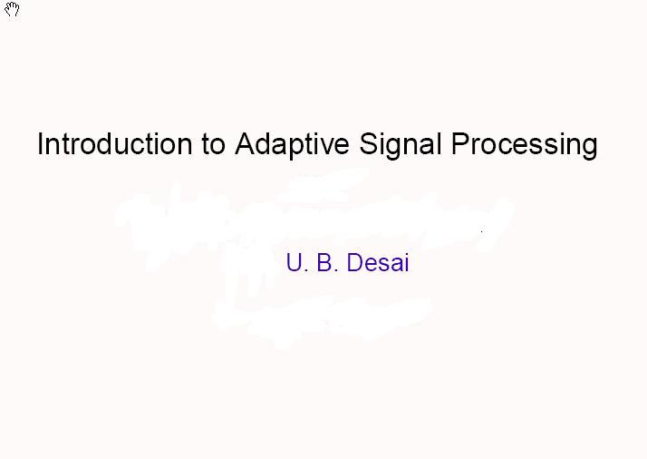


Slide 3
TAs
Deepthi Chander
dchander@ee.iitb.ac.in
Bhushan Jagyasi bhushan.jagyasi@iitb.ac.in
Phone: 4478

Slide 4
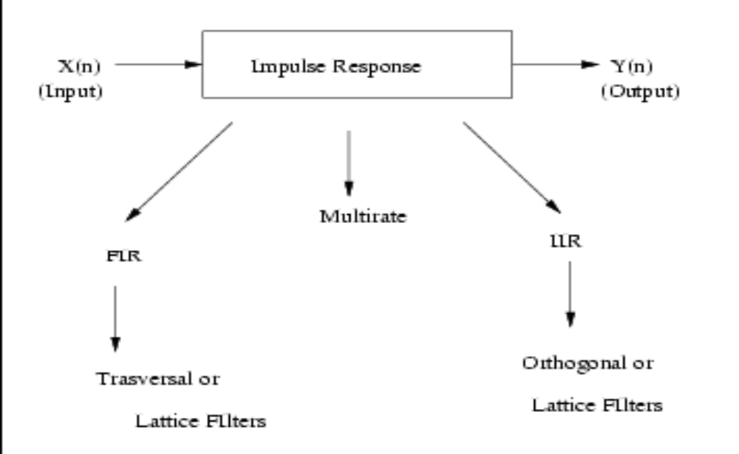
Non-Adaptive Digital Filter

Slide 5
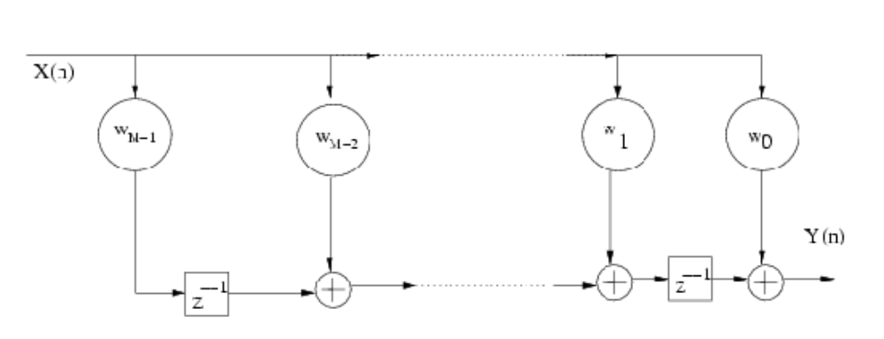

Non-Adaptive Transversal Filter

Slide 6
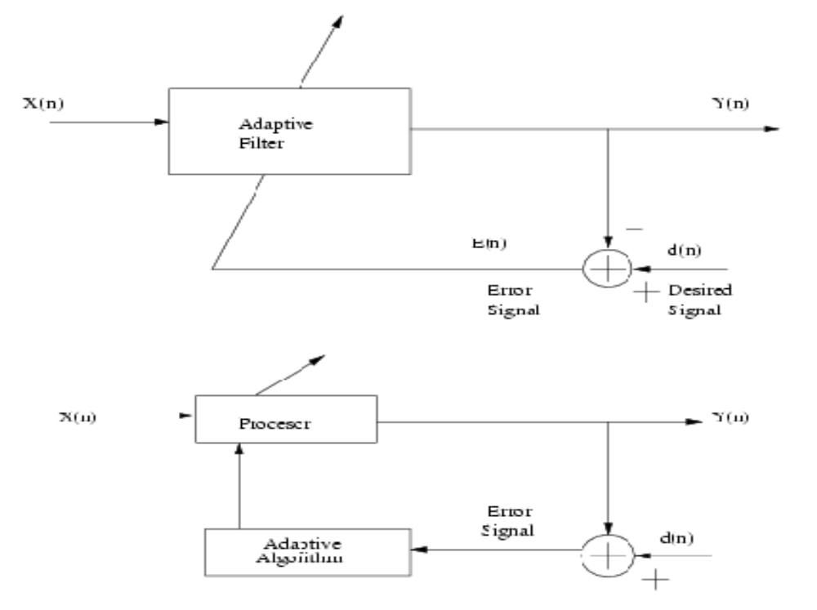
Typical Structure of Adaptive Filter
Filter weight
Data dependent
Weights change
with changing
characteristics
of the data

Slide 7
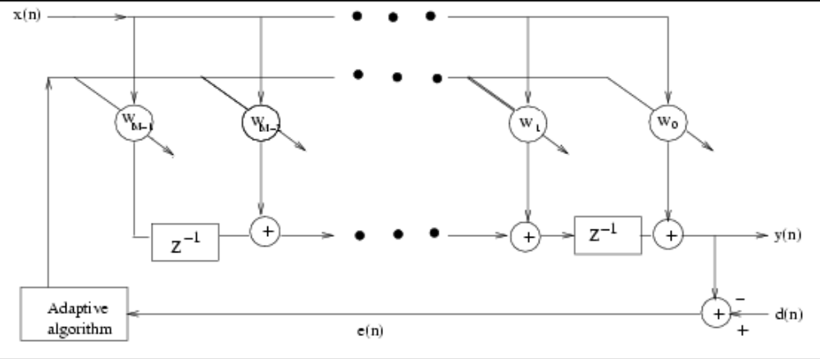
FIR Adaptive Filter
Basic tasks is to develop adaptive algorithms for adjusting the filter weights Wi
Most common approach is to select the weights Wi such that E[e^{2}(n)] is minimized for each n
Obvious Question: If the desired signal d(n) is already known and available what is the purpose of adaptive filtering?
Answer obtained by looking at examples

Slide 8
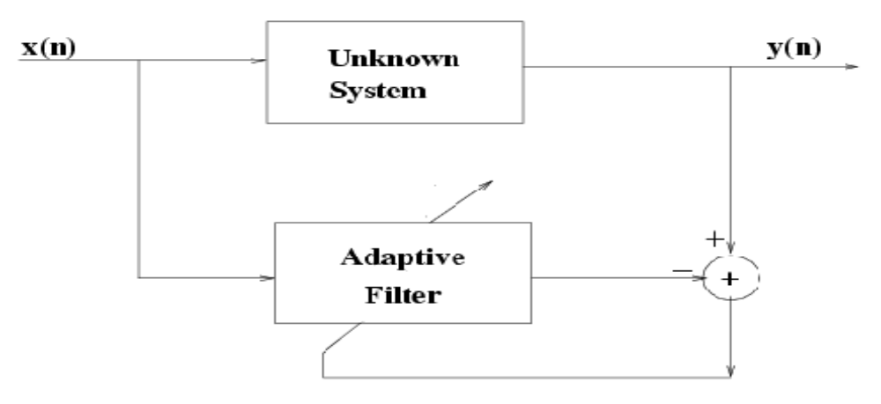
System Modeling
Role of the desired signal is played by the output of the unknown system
Usually decision on M is made by the designer
There are algorithms which update M as the new data arrives (we will see on when discuss Levinson’s algorithm)

Slide 9
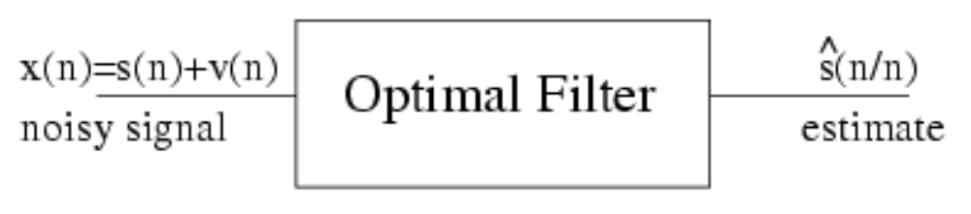
Estimation
Standard Approach
Here we need a model of s(n) for
designing the optimal filter

Slide 10
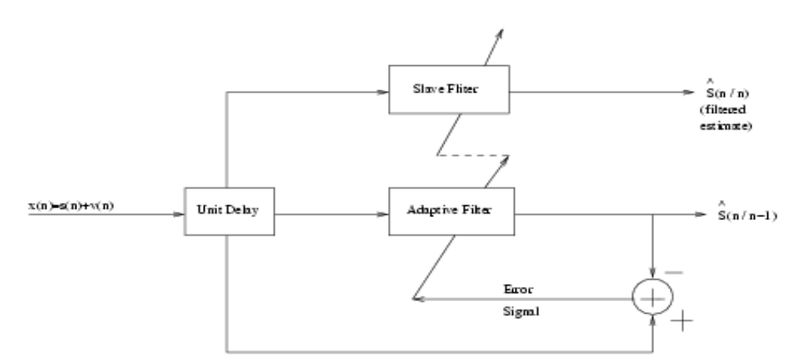

Adaptive Approach

Slide 11
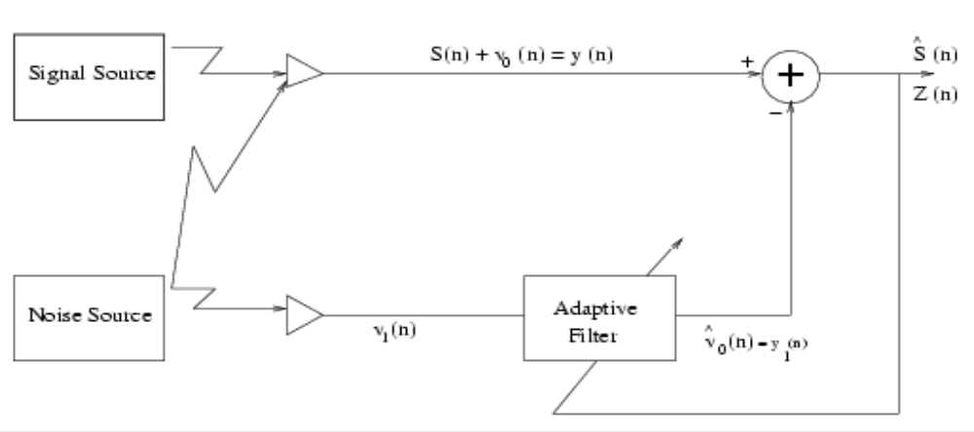
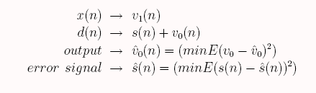
Noise Cancellation

Slide 15
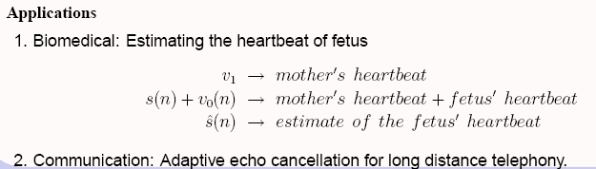

Slide 16
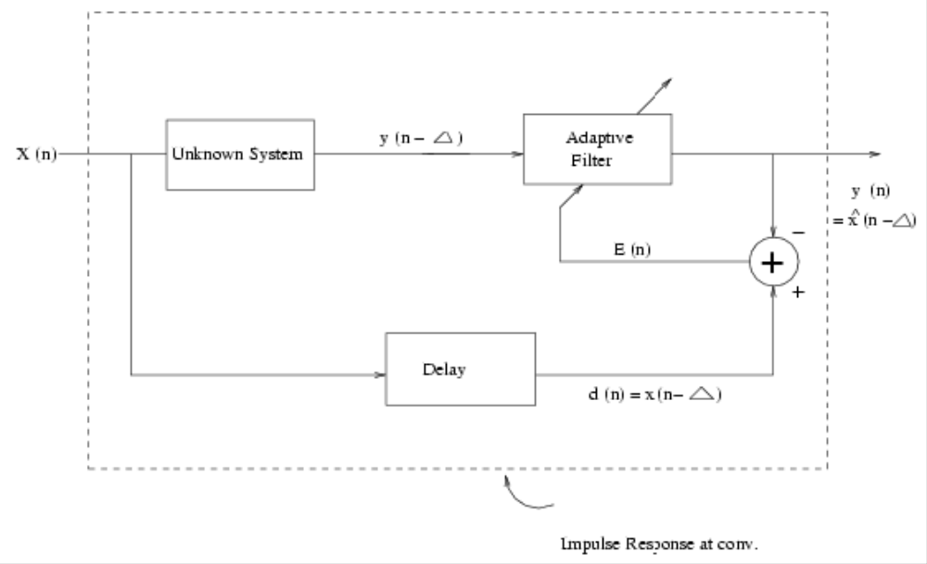
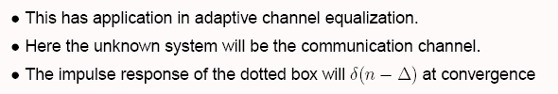
Inverse Modeling

Slide 17
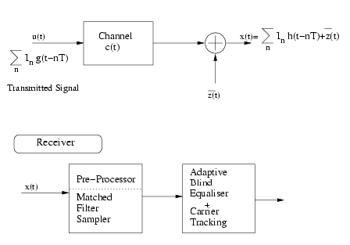

Adaptive Blind Equalization

Slide 18
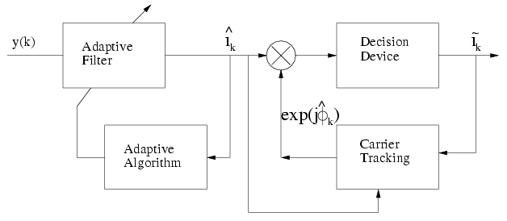

Structure for Adaptive Blind Equalization and Carrier Tracking

